Slide 1
Drift-Independent Volatility Estimation Based on High, Low, Open, and Close Prices
Summary Brief

Slide 2
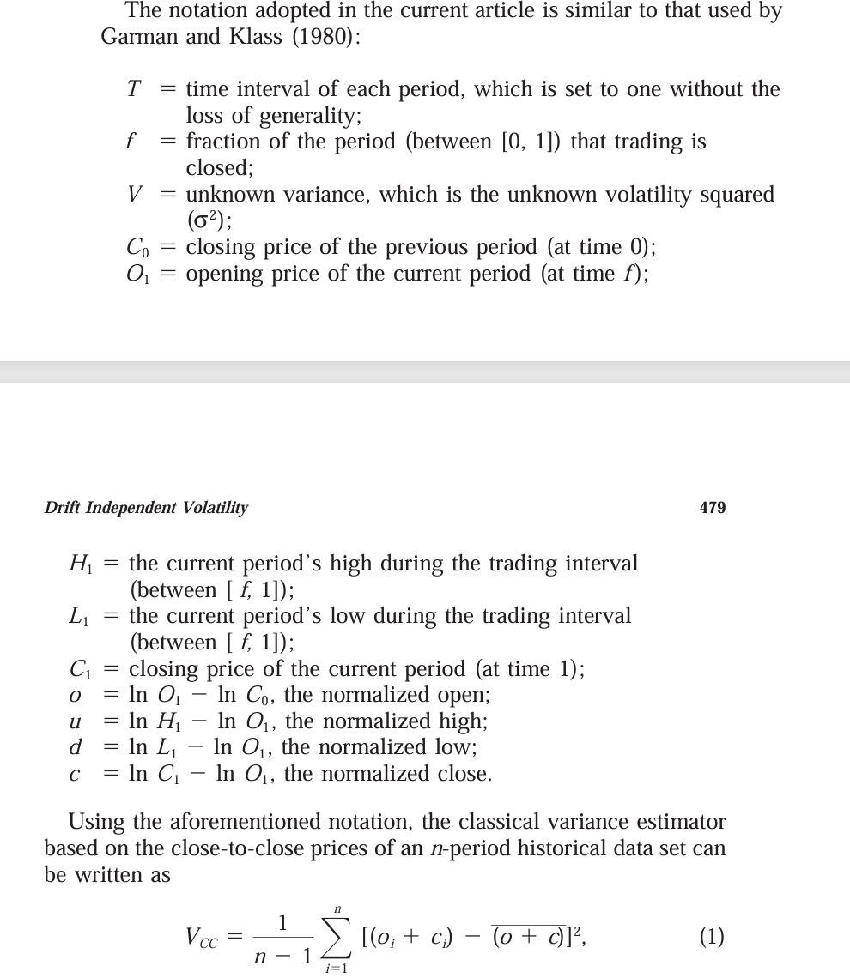
Parameters Definition

Slide 3
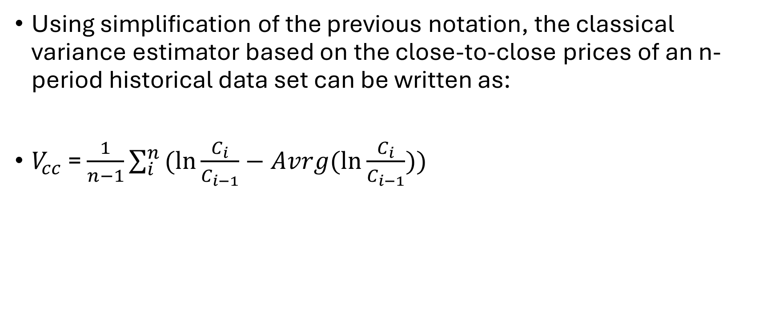
Formal definition equivalence for VCC
Using simplification of the previous notation, the classical variance estimator based on the close-to-close prices of an n-period historical data set can be written as:
$V_{cc}$ = $\frac{1}{n−1}\sum_{i}^{n}{(ln{\frac{C_{i}}{C_{i−1}}}}−Avrg(\ln{\frac{C_{i}}{C_{i−1}}}))$

Slide 4
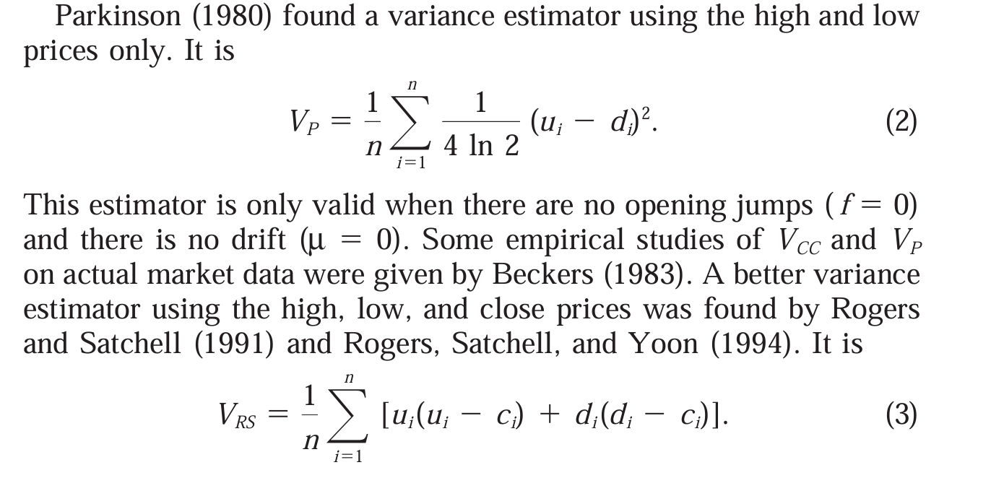
Better Estimator Selection

Slide 5
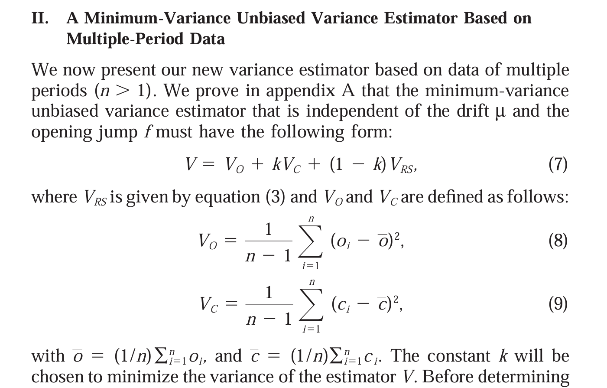
Variance Unbiased Estimator

Slide 6
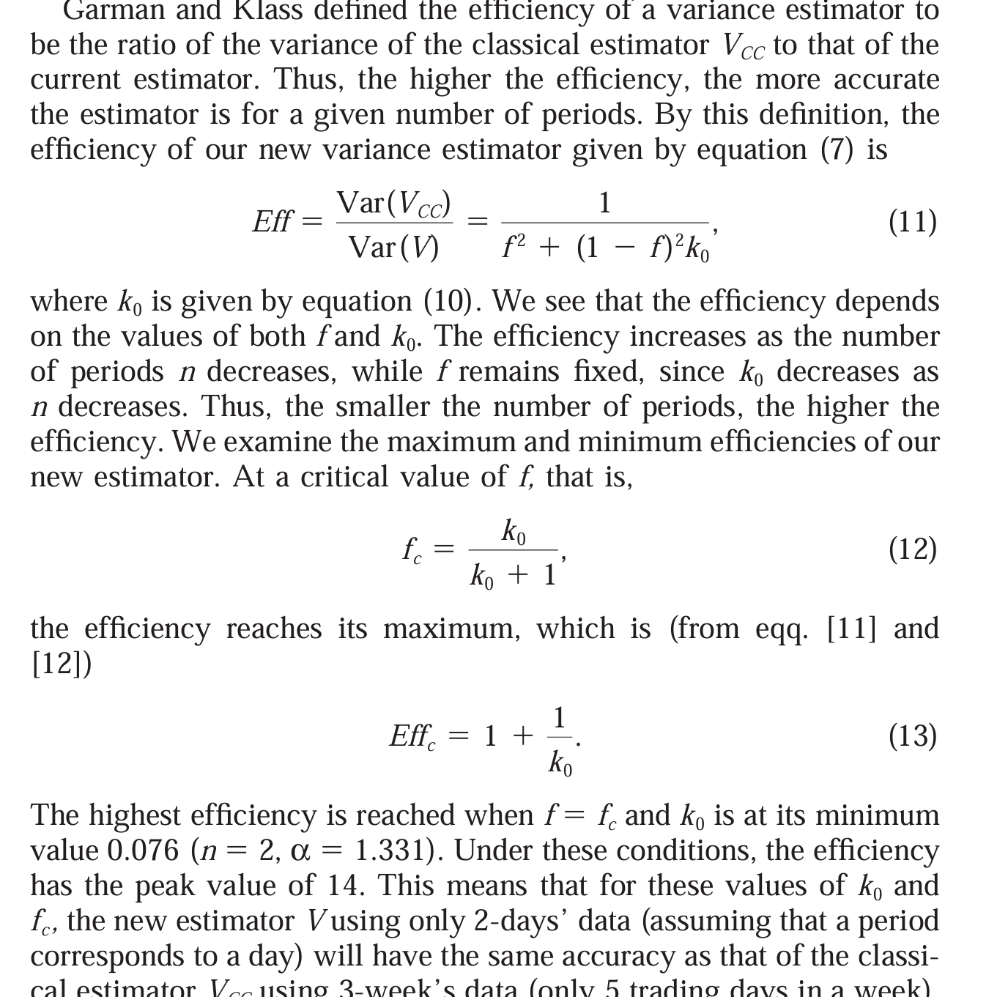
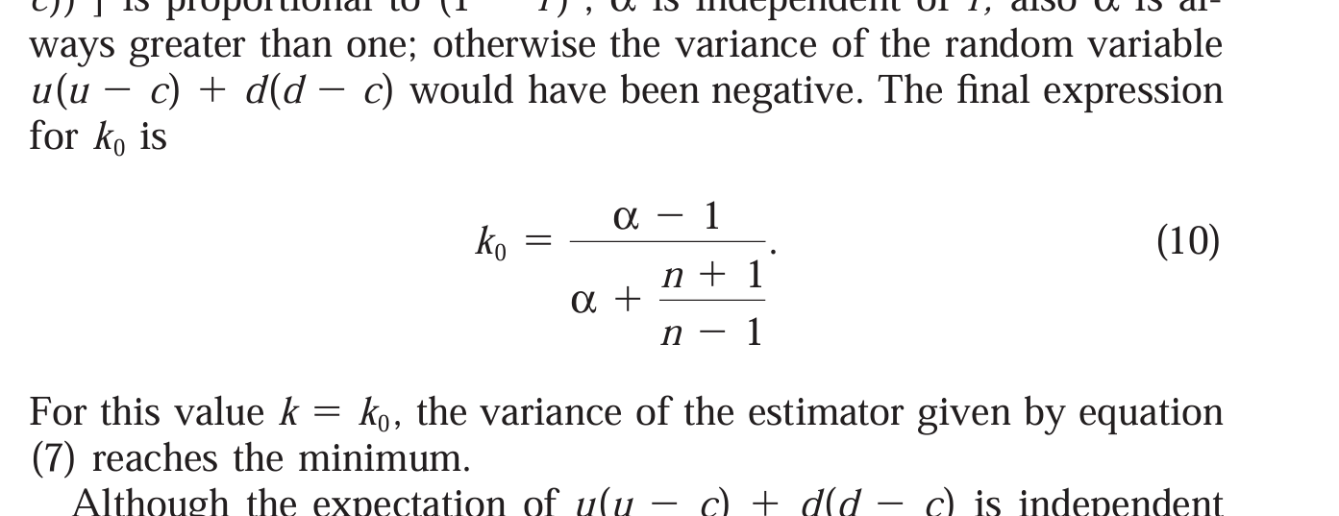
Consideration on f = Ratio of Market Time Close over Time Open
Measurement indicate that the historical average is 0.25 for the US market rather than the 0.66 exact time calculation. This is the ratio between the Close to open volatility measurement. Below we have the definition of fc

Slide 7

Calculation for k0
$${k=k}_{0}≡\frac{E\left[\left(V_{O}+V_{RS}\right)\left(V_{RS}−V_{C}\right)\right]}{E\left[{\left(V_{RS}−V_{C}\right)}^{2}\right]}$$

Slide 8
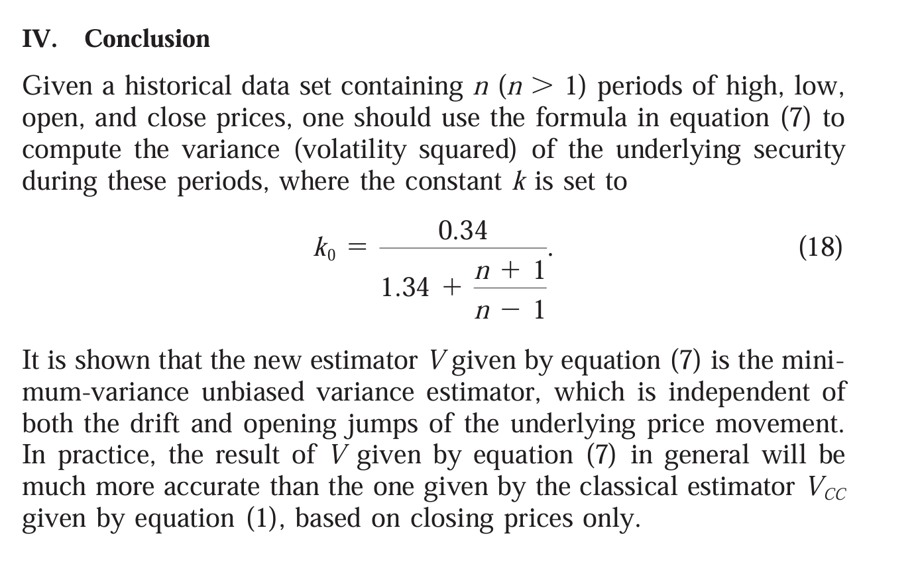
Conclusion

